Slide 1

A Project Proposal Presentation On
MedAppoint: Doctor Appointment System
Submitted in Partial Fulfillment of the Requirements for
The Degree of Bachelor of Engineering in Information Technology
Under Pokhara University
Submitted by:
Aman Sheikh, 211506, Shikshya K.C., 211541, Shreya Khanal, 211546
Introduction
MedAppoint: Doctor Appointment System is a technological solution designed to address the evolving needs and challenges within the healthcare sector. This innovative platform leverages digital advancements to streamline and enhance the process of scheduling appointments with healthcare professionals. In this section, problems, project objectives, it’s significance, project scope, and limitations will be described in detail.

Slide 2
A Project Proposal Presentation On
MedAppoint: Doctor Appointment System
Submitted in Partial Fulfillment of the Requirements for
The Degree of Bachelor of Engineering in Information Technology
Under Pokhara University
Submitted by:
Aman Sheikh, 211506, Shikshya K.C., 211541, Shreya Khanal, 211546
Introduction
MedAppoint: Doctor Appointment System is a technological solution designed to address the evolving needs and challenges within the healthcare sector. This innovative platform leverages digital advancements to streamline and enhance the process of scheduling appointments with healthcare professionals. In this section, problems, project objectives, it’s significance, project scope, and limitations will be described in detail.
Acknowledgment
The continuous advancement of the "MedAppoint: Doctor Appointment System" project is attributed to the collaborative efforts of numerous individuals. We extend our sincere gratitude to all who have played a role in its progression. A special acknowledgment is reserved for our esteemed project supervisor, Subash Manandhar, for providing invaluable support and guidance throughout the development. We express appreciation to the Department of Information Technology, NCIT, for facilitating the platform for this mid-term project. In conclusion, we extend our thanks to the respected teachers, colleagues, and all contributors who have been instrumental in this project, providing unwavering support and valuable insights during the development phase.

Slide 3
Introduction
MedAppoint: Doctor Appointment System is a technological solution designed to address the evolving needs and challenges within the healthcare sector. This innovative platform leverages digital advancements to streamline and enhance the process of scheduling appointments with healthcare professionals. In this section, problems, project objectives, it’s significance, project scope, and limitations will be described in detail.
Acknowledgment
The continuous advancement of the "MedAppoint: Doctor Appointment System" project is attributed to the collaborative efforts of numerous individuals. We extend our sincere gratitude to all who have played a role in its progression. A special acknowledgment is reserved for our esteemed project supervisor, Subash Manandhar, for providing invaluable support and guidance throughout the development. We express appreciation to the Department of Information Technology, NCIT, for facilitating the platform for this mid-term project. In conclusion, we extend our thanks to the respected teachers, colleagues, and all contributors who have been instrumental in this project, providing unwavering support and valuable insights during the development phase.
Problem Statement
Time Consuming Manual Processes
Appointment Conflicts and Overbooking
Limited Accessibility
Missed Appointments and No-Shows
Limited Patient Engagement
Lack of Real-time Information
Inefficient Resource Allocation
Difficulty in Managing Multiple Providers

Slide 4
Problem Statement
Time Consuming Manual Processes
Appointment Conflicts and Overbooking
Limited Accessibility
Missed Appointments and No-Shows
Limited Patient Engagement
Lack of Real-time Information
Inefficient Resource Allocation
Difficulty in Managing Multiple Providers
Objectives
“
Efficient Appointment Scheduling
Real-time Availability Information
Centralized Patient Information
User Authentication and Security
Multi-Provider Support
Customizable Profiles
”

Slide 5
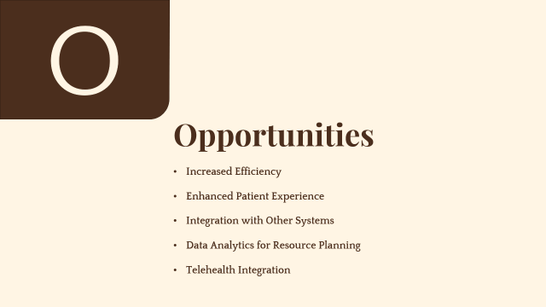
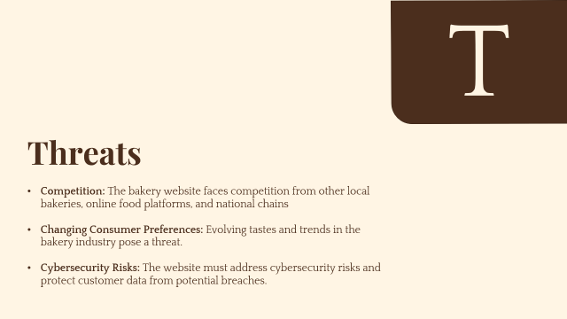
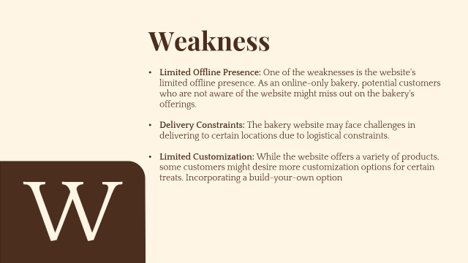
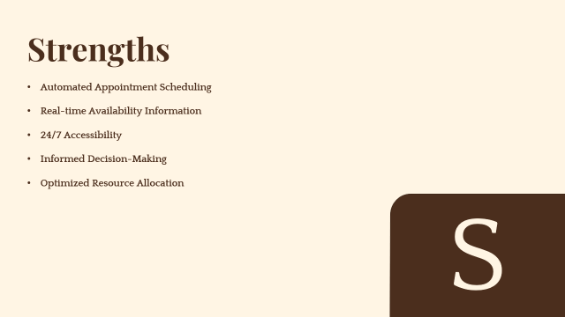
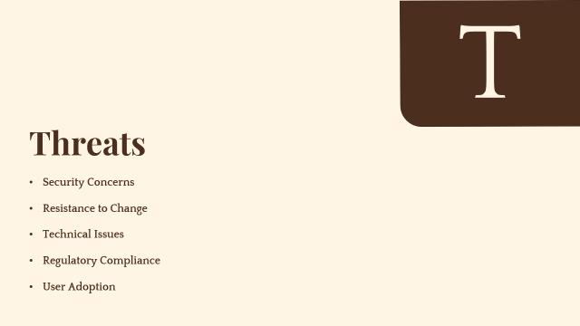
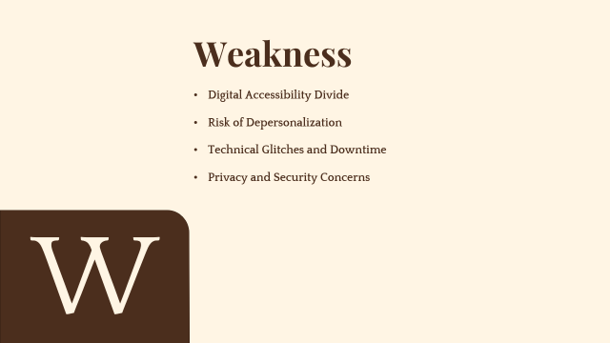
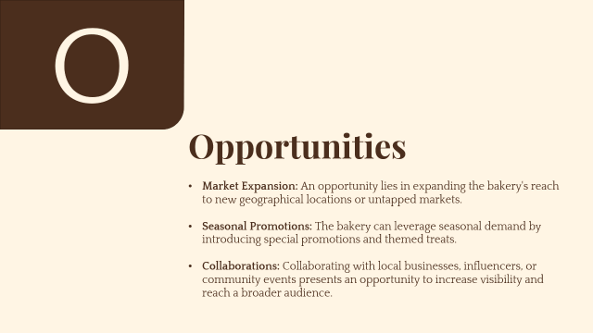
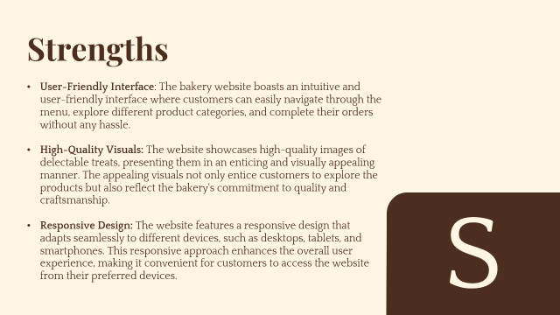
Problem Statement
Time Consuming Manual Processes
Appointment Conflicts and Overbooking
Limited Accessibility
Missed Appointments and No-Shows
Limited Patient Engagement
Lack of Real-time Information
Inefficient Resource Allocation
Difficulty in Managing Multiple Providers
Objectives
Efficient Appointment Scheduling
Real-time Availability Information
Centralized Patient Information
User Authentication and Security
Multi-Provider Support
Customizable Profiles

Slide 6
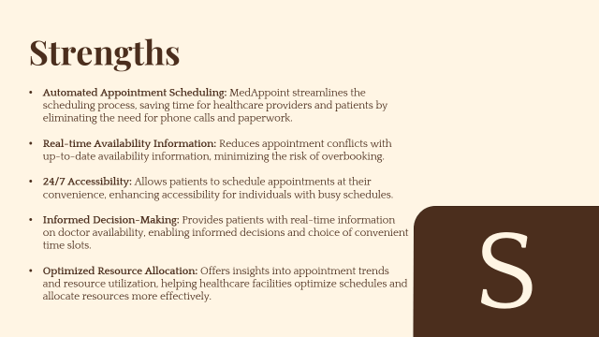

Slide 7
Strengths
Automated Appointment Scheduling
Real-time Availability Information
24/7 Accessibility
Informed Decision-Making
Optimized Resource Allocation
S

Slide 8
Weakness
Digital Accessibility Divide
Risk of Depersonalization
Technical Glitches and Downtime
Privacy and Security Concerns
W

Slide 9
O
Opportunities
Increased Efficiency
Enhanced Patient Experience
Integration with Other Systems
Data Analytics for Resource Planning
Telehealth Integration

Slide 10
T
Threats
Security Concerns
Resistance to Change
Technical Issues
Regulatory Compliance
User Adoption
Methodology
Incremental Software Development: Project follows incremental approach for segmented development and testing cycles.
Programming Language and Database: Developed using PHP with MySQL database backend.
Comprehensive Platform Design: System designed as a website for doctor appointments accessible from any internet-connected device.
Operational Modules: Includes modules for user (patient) registration, doctor viewing, appointment scheduling, and payment.
Three-Tier Technical Architecture: Client-side (presentation layer): HTML, CSS, and JavaScript for user-friendly design.
Server-side (application layer): PHP for data processing functions.
Database layer: MySQL for data storage and retrieval.
Security Measures: Role-based access control, data encryption, and regular data backups ensure privacy and confidentiality of patient data.

Slide 11
T
Methodology
Incremental Software Development: Project follows incremental approach for segmented development and testing cycles.
Programming Language and Database: Developed using PHP with MySQL database backend.
Comprehensive Platform Design: System designed as a website for doctor appointments accessible from any internet-connected device.
Operational Modules: Includes modules for user (patient) registration, doctor viewing, appointment scheduling, and payment.
Three-Tier Technical Architecture: Client-side (presentation layer): HTML, CSS, and JavaScript for user-friendly design.
Server-side (application layer): PHP for data processing functions.
Database layer: MySQL for data storage and retrieval.
Security Measures: Role-based access control, data encryption, and regular data backups ensure privacy and confidentiality of patient data.
Threats
Competition: The bakery website faces competition from other local bakeries, online food platforms, and national chains
Changing Consumer Preferences: Evolving tastes and trends in the bakery industry pose a threat.
Cybersecurity Risks: The website must address cybersecurity risks and protect customer data from potential breaches.

Slide 12
SDLC
Methodology
Three-Tier Technical Architecture: Client-side (presentation layer): HTML, CSS, and JavaScript for user-friendly design.
Server-side (application layer): PHP for data processing functions.
Database layer: MySQL for data storage and retrieval.
Security Measures: Role-based access control, data encryption, and regular data backups ensure privacy and confidentiality of patient data.

Slide 13
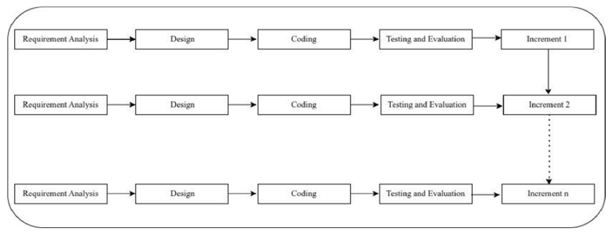
Incremental Model Overview:
Approach involves breaking down development into smaller increments.
Phases: Requirement Analysis, Design, Implementation, Testing, and Maintenance.
First Increment: Core Product Development
Major functionalities developed: user account creation, login, and appointment scheduling for users (patients).
Second Increment: Dashboard Implementation
Introduced a dashboard with doctor profiles, allowing users (patients) to view, book appointments, manage their profiles, and enabled admin to oversee doctors and patients.
Third Increment: Payment Integration
Added a payment page for users (patients) to make payments after scheduling appointments with doctors.
SDLC
Methodology
Three-Tier Technical Architecture: Client-side (presentation layer): HTML, CSS, and JavaScript for user-friendly design.
Server-side (application layer): PHP for data processing functions.
Database layer: MySQL for data storage and retrieval.
Security Measures: Role-based access control, data encryption, and regular data backups ensure privacy and confidentiality of patient data.

Slide 14
SDLC
Incremental Model Overview:
Approach involves breaking down development into smaller increments.
Phases: Requirement Analysis, Design, Implementation, Testing, and Maintenance.
First Increment: Core Product Development
Major functionalities developed: user account creation, login, and appointment scheduling for users (patients).
Second Increment: Dashboard Implementation
Introduced a dashboard with doctor profiles, allowing users (patients) to view, book appointments, manage their profiles, and enabled admin to oversee doctors and patients.
Third Increment: Payment Integration
Added a payment page for users (patients) to make payments after scheduling appointments with doctors.
Implementation
Testing
Analysis
Design
Maintenance

Slide 15
SDLC
Incremental Model Overview:
Approach involves breaking down development into smaller increments.
Phases: Requirement Analysis, Design, Implementation, Testing, and Maintenance.
First Increment: Core Product Development
Major functionalities developed: user account creation, login, and appointment scheduling for users (patients).
Second Increment: Dashboard Implementation
Introduced a dashboard with doctor profiles, allowing users (patients) to view, book appointments, manage their profiles, and enabled admin to oversee doctors and patients.
Third Increment: Payment Integration
Added a payment page for users (patients) to make payments after scheduling appointments with doctors.
Requirements Gathering
User Stories: Develops user stories to capture detailed requirements from the perspectives of different system users, including patients, healthcare providers, and administrators.
Functional Requirements: Specifies the functional requirements of the system, including appointment scheduling, user registration, user authentication, notifications, and reporting functionalities.
Non-Functional Requirements: Identify non-functional requirements such as system performance, security, privacy, and scalability to ensure the system meets the necessary quality attributes.
Requirements Gathering
Analysis
Implementation
Design
Testing
Maintenance

Slide 16
Analysis
Business Process Analysis: Analyzing existing business processes related to appointment scheduling, patient management, and administrative tasks to identify areas for improvement.
Feasibility Study: Conduct a feasibility study to assess the technical, operational, and economic feasibility of implementing the system.
Risk Analysis: Identifying potential risks associated with the project, including technical challenges, resource constraints
Implementation
Testing
Analysis
Design
Maintenance

Slide 17
Design
System Architecture: Defines the technical architecture of the system, outlining how the client-side, server-side, and database components will interact using technologies like HTML, CSS, JavaScript, PHP, and MySQL.
Database Design: Creates a database schema that efficiently stores and retrieves data related to users, appointments, and other relevant entities. Establishes relationships between tables for data consistency.
User Interface Design: Develops intuitive and user-friendly interfaces for patients, healthcare providers, and administrators. Ensures a responsive design for accessibility across different devices.
Design
Implementation
Testing
Maintenance

Slide 18
The About Us page shares our bakery's story, rooted in a passion for baking and a commitment to quality.
Customers get a glimpse of the bakers behind the scenes and the love they pour into every creation.
Implementation
Coding Standards: Utilizes PHP for server-side scripting and HTML, CSS, and JavaScript for client-side development.
Security Measures: Implements secure coding practices, including data encryption, secure user authentication, and protection against common web vulnerabilities
Testing
Implementation
Maintenance

Slide 19
Testing
Performance Testing: Evaluates the system’s performance under various conditions, ensuring it can handle the expected load and response times are acceptable.
Security Testing: Conducts thorough security testing to identify and address potential vulnerabilities, protecting sensitive patient information.
Implementation
Maintenance
Testing

Slide 20
Maintenance
Updates and Enhancements: Plans for periodic updates and enhancements to address emerging needs, improve functionality, and incorporate user feedback
Testing
Maintenance

Slide 21
Technology Used

Slide 22

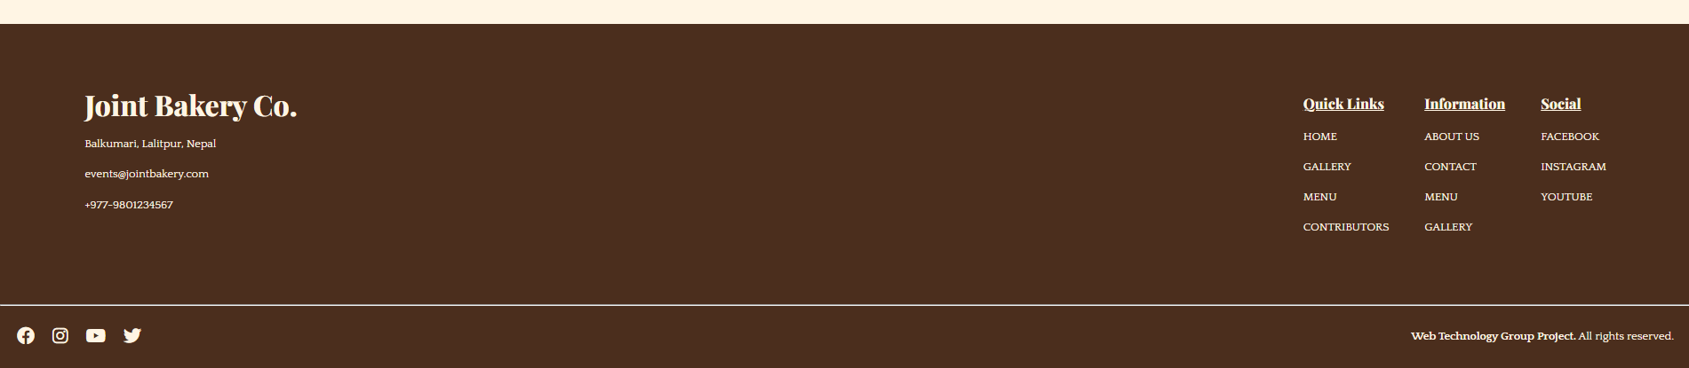
Technology Used
HTML
CSS
JavaScript
PHP
MySQL
Git and GitHub
VS Code
Web's building blocks.
Fundamental for web page creation
Uses tags to structure content
Browser-readable for text, images, links
Supports form creation for user input
Foundation for web development with CSS and JavaScript
Hierarchical structure with elements like head, body, paragraphs, headings, lists.
HTML5 is the latest version
01
02
03
04
Custom properties
The use of custom properties (--*) for commonly used property values for increased flexibility.
var() for attributes
The var() is used along with custom properties that increases code reusability and reduce lines of CSS code
Classes
Used Custom made classes for commonly used CSS properties.
Transition and animation
Use of transition and animation property for fluid and user friendly interface.

Slide 23

Technology Used
HTML
CSS
JavaScript
PHP
MySQL
Git and GitHub
VS Code
Web's style maestro.
Styles web pages, enhancing visual presentation
Supports layout adjustments and responsive design
Utilizes properties like color, font, margin, padding
Simplifies site-wide changes through centralized styling
Enhances user experience through improved aesthetics
Critical component of modern web development

Slide 24

Technology Used
HTML
CSS
JavaScript
PHP
MySQL
Git and GitHub
VS Code
Empowering web interactivity and dynamism.
Web scripting language for interactivity.
Client-side execution in the user's browser.
Seamless integration with HTML and CSS.
Enables dynamic content and real-time updates.

Slide 25

Technology Used
HTML
CSS
JavaScript
PHP
MySQL
Git and GitHub
VS Code
Server-side dynamism for web applications.
Server-side scripting language.
Creates dynamic content for web development.
Embedded within HTML.
Executes on the server for enhanced functionality.
Widely used in building interactive web applications.

Slide 26

Technology Used
HTML
CSS
JavaScript
PHP
MySQL
Git and GitHub
VS Code
Fueling dynamic web data with precision.
A relational database management system.
Efficiently organizes and retrieves data.
Used for dynamic, data-driven web applications.
Supports SQL for managing and querying databases.
Essential for storing and retrieving structured information on the web.

Slide 27


Technology Used
HTML
CSS
JavaScript
PHP
MySQL
Git and GitHub
VS Code
Empowering seamless collaboration through version control
Git: Distributed version control system for tracking changes in source code.
GitHub: Online platform leveraging Git for collaborative software development.
Enables multiple contributors to work on projects simultaneously.
Facilitates version tracking, collaboration, and code review.
Centralized repository hosting for open-source and private projects.

Slide 28

Technology Used
HTML
CSS
JavaScript
PHP
MySQL
Git and GitHub
VS Code
Laravel
XAMPP
Tailwind CSS
Versatile code editor for streamlined and efficient coding.
A feature-rich and extensible code editor.
Developed by Microsoft.
Supports various programming languages.
Offers an array of extensions for enhanced functionality.
Provides a customizable and user-friendly interface.
Widely used for web development, scripting, and more.

Slide 29

Technology Used
HTML
CSS
JavaScript
PHP
MySQL
Git and GitHub
VS Code
Laravel
XAMPP
Tailwind CSS
Elegant PHP framework for crafting modern and scalable web applications.
A PHP web application framework.
Focuses on simplicity, elegance, and expressive syntax.
Offers features like routing, ORM, and templating.
Emphasizes developer-friendly and scalable code.
Facilitates the rapid development of robust web applications.
Widely used in modern PHP development for its rich features.

Slide 30

Technology Used
HTML
CSS
JavaScript
PHP
MySQL
Git and GitHub
VS Code
Laravel
XAMPP
Tailwind CSS
All-in-one solution for local web development environments.
A free and open-source cross-platform web server solution.
Bundles Apache, MySQL, PHP, and Perl for easy local development.
Provides a pre-configured environment for testing and debugging.
Streamlines the setup of web development environments on personal machines.

Slide 31

Technology Used
HTML
CSS
JavaScript
PHP
MySQL
Git and GitHub
VS Code
Laravel
XAMPP
Tailwind CSS
Modern and customizable CSS utility framework.
A utility-first CSS framework.
Emphasizes building designs through pre-defined utility classes.
Enables rapid and highly customizable styling.
Provides a low-level utility approach for flexibility and speed.
Popular for creating modern and responsive web interfaces.

Slide 32
Task Done So Far

Slide 33
Task Done So Far
Requirement Analysis
Documented functional and non-functional requirements for the system.
Prioritized requirements based on their importance and impact.

Slide 34
Task Done So Far
Database Design
Designed and implemented the relational database schema to store and manage patient records, doctor records, and billing information.
Created tables, relationships, and attributes to capture relevant information accurately.
Addressed challenges related to data integrity and optimized query performance

Slide 35
Task Done So Far
User Interface Design
Developed an intuitive and user-friendly interface for the system.
Designed screens for patient and billing management modules.
Implemented a dashboard listing doctor profiles for appointment scheduling.
Created patient dashboard for profile management.
Developed an admin dashboard for managing doctor and patient information.

Slide 36
Task Done So Far
Development
Implemented core functionality using HTML, CSS, JavaScript, PHP, and MySQL.
Developed user(patient) management module for registration and information management.
Created an appointment page for users(patients) to select and book appointments with specialized doctors.
Integrated front-end components and back-end using Laravel Blade templates.

Slide 37
Results

Slide 38
Results
1. Functional Modules Achieved:
Patient Management: Allows user registration, appointment scheduling, and profile maintenance.
Healthcare Provider Management: Enables providers to create and manage profiles, view patient records, and access appointment lists.
Resource Management: Admin functionality for user accounts, permissions, secure authentication, schedule monitoring, and financial processes.

Slide 39
Results
2. Database Design:
Implemented a structured database schema for efficient data storage and management.
3. User Interface:
Designed an intuitive and user-friendly interface for easy navigation and efficient system interaction.
Discussion
Project Foundation:
Mid-term progress lays a strong foundation for completing MedAppoint: Doctor Appointment System.
2. Module Impact:
Patient Management ensures efficient record access.
Resource Management ensures secure data handling, schedule management, and billing transparency.
3.Database and UI Impact:
Structured database design enables efficient data retrieval.
User interface design prioritizes usability, enhancing system interaction.
4.Moving Forward:
Ongoing development to include more modules, testing, and refinement.
Goal: Deliver a robust, user-friendly system meeting patient requirements and enhancing capabilities.

Slide 40
Results
Discussion
Project Foundation:
Mid-term progress lays a strong foundation for completing MedAppoint: Doctor Appointment System.
2. Module Impact:
Patient Management ensures efficient record access.
Resource Management ensures secure data handling, schedule management, and billing transparency.
3.Database and UI Impact:
Structured database design enables efficient data retrieval.
User interface design prioritizes usability, enhancing system interaction.
4.Moving Forward:
Ongoing development to include more modules, testing, and refinement.
Goal: Deliver a robust, user-friendly system meeting patient requirements and enhancing capabilities.

Slide 41
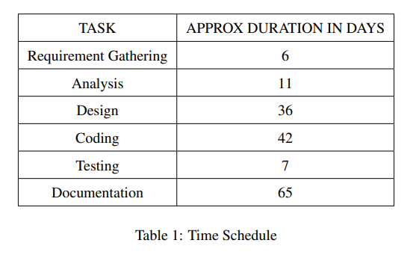
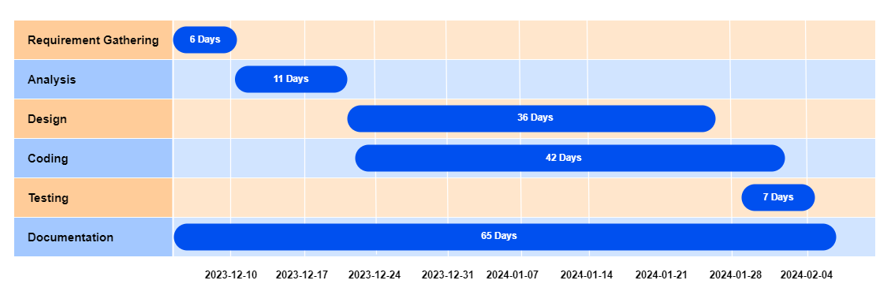
Results
Project Foundation:
Mid-term progress lays a strong foundation for completing MedAppoint: Doctor Appointment System.
2. Module Impact:
Patient Management ensures efficient record access.
Resource Management ensures secure data handling, schedule management, and billing transparency.
3.Database and UI Impact:
Structured database design enables efficient data retrieval.
User interface design prioritizes usability, enhancing system interaction.
4.Moving Forward:
Ongoing development to include more modules, testing, and refinement.
Goal: Deliver a robust, user-friendly system meeting patient requirements and enhancing capabilities.
Discussion
Task and Time schedule
The project schedule has been designed as per the requirements and constraints involved.
This project is estimated to be completed in about 9-10 weeks.
Research and database management is to be done first and well documented.
Debugging and testing are to be done prior to the completion of the project.

Slide 42
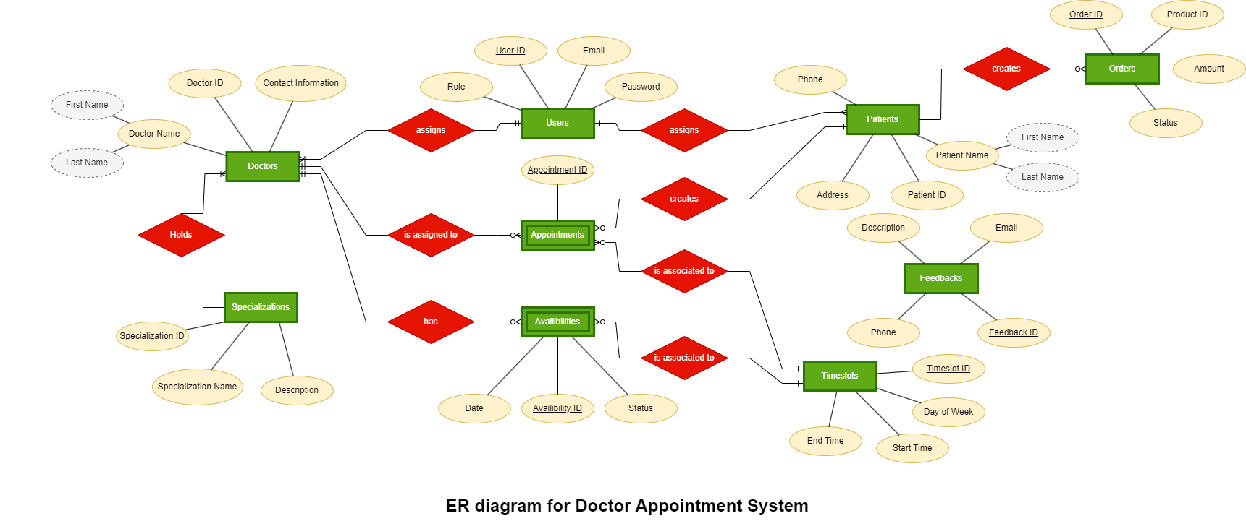
Project Foundation:
Mid-term progress lays a strong foundation for completing MedAppoint: Doctor Appointment System.
2. Module Impact:
Patient Management ensures efficient record access.
Resource Management ensures secure data handling, schedule management, and billing transparency.
3.Database and UI Impact:
Structured database design enables efficient data retrieval.
User interface design prioritizes usability, enhancing system interaction.
4.Moving Forward:
Ongoing development to include more modules, testing, and refinement.
Goal: Deliver a robust, user-friendly system meeting patient requirements and enhancing capabilities.
Discussion
Results
Task and Time schedule
The project schedule has been designed as per the requirements and constraints involved.
This project is estimated to be completed in about 9-10 weeks.
Research and database management is to be done first and well documented.
Debugging and testing are to be done prior to the completion of the project.
ER- Diagram

Slide 43
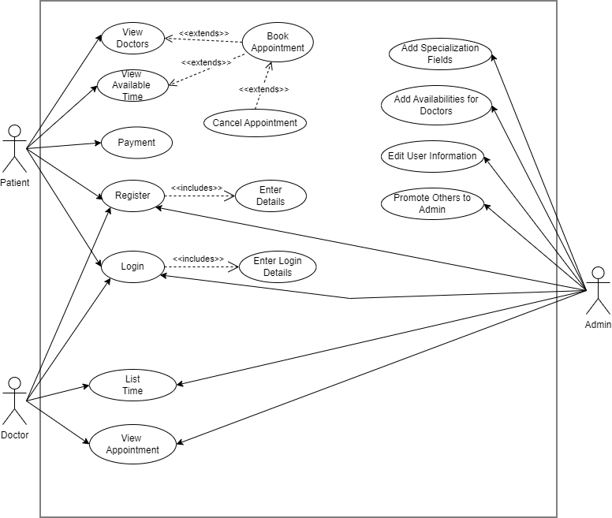
Task and Time schedule
The project schedule has been designed as per the requirements and constraints involved.
This project is estimated to be completed in about 9-10 weeks.
Research and database management is to be done first and well documented.
Debugging and testing are to be done prior to the completion of the project.
ER- Diagram
Use-Case Diagram

Slide 44
ER- Diagram
Use-Case Diagram

